Slide 1
Library of Congress Faceted Vocabularies and the Contributions of the SAC Subcommittee on Genre/Form Implementation
Adam L. Schiff
Principal Cataloger, University of Washington Libraries
aschiff@uw.edu
http://faculty.washington.edu/aschiff/
NYTSL Spring 2019 Program
Stephen A. Schwarzman Building, New York Public Library
May 14, 2019

Slide 2
Reference Questions
Do you have any novels by New Zealand authors? Any of those by Maori?
I’m looking for concertos composed by French women.
What Mexican films do you have? Any from the 1960s?
I need chamber music for oboe written between 1950 and 2000 by German, Austrian, or Dutch composers.
Do you have any graphic novels for preteens?
Can you use your discovery system to answer these questions? Let’s look at one system and see how it can help.
Notes:
If someone comes up to the reference desk with questions like the ones above, or tries to search in your online catalog, how easy is it to give them what they are looking for? These types of questions have not been easy to help with. Until now.

Slide 3
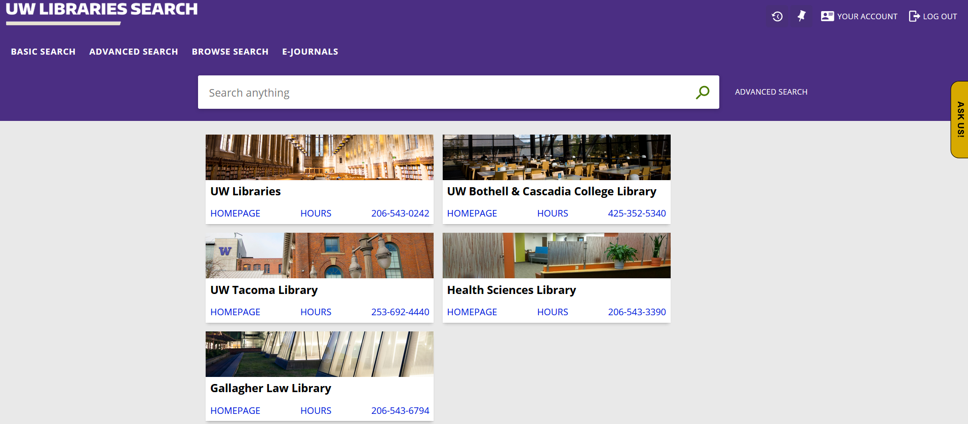
https://tinyurl.com/y2pg6sy3
Notes:
Let’s have a look at the University of Washington Libraries Primo discovery system. What I’m showing is not what our patrons see, however, it’s a premium sandbox version.

Slide 4
So how did we get here?
LCSH for many decades included headings and subdivisions that were used to describe what a resource is rather than what it is about
Symphonies American poetry Young adult fiction
These headings have long been coded in field 650 - Subject Added Entry-Topical Term even though they don’t always describe the subject of a resource
MARC bibliographic field 655 - Index Term-Genre/Form was added to the format in 1981 at the request of ALA Rare Books and Manuscripts Section
MARC genre/form authority fields 155, 455, 555, 755 were added in 1995

Slide 5
So how did we get here?
Since the 1980s, LC has been supplementing LCSH with discipline‐specific guides and thesauri of genre/form terms developed within LC (e.g., Thesaurus for Graphic Materials; Moving Image Genre-Form Guide) and by outside parties (Guidelines on Subject Access to Individual Works of Fiction, Drama, Etc.; Art & Architecture Thesaurus)
In 2007, at the behest of the community, LC began a project to develop a separate vocabulary for genre/form terms, for use in field 655
Goal: “To develop a dynamic, multi‐disciplinary body of genre/form terms that is cohesive, unified, intuitive, and user‐friendly”
LC decided that each discipline should be handled as a separate project
Notes:
Information taken from Introduction to Library of Congress Genre/Form Terms for Library and Archival Materials - https://www.loc.gov/aba/publications/FreeLCGFT/2019%20LCGFT%20intro.pdf

Slide 6
So how did we get here?
Library of Congress Genre/Form Terms for Library and Archival Materials (LCGFT)
First three projects were completed in house: terms for moving images (2007), radio programs (2008), and cartographic materials (2010)
Next six projects were collaborations with outside organizations: law (AALL - 2010), general materials (ALA SAC - 2015), music (MLA - 2015), literature (ALA SAC - 2015), religion (ATLA - 2015), and artistic/visual works (ARLIS - 2018)
All terms except for artistic/visual are now open for SACO proposals
Notes:
Information taken from Introduction to Library of Congress Genre/Form Terms for Library and Archival Materials - https://www.loc.gov/aba/publications/FreeLCGFT/2019%20LCGFT%20intro.pdf

Slide 7
ALA SAC Subcommittee on Genre/Form Implementation
Schiff served as Chair, 2010-2016
New Yorkers were heavily involved in committee and task group efforts
Developed initial list of literature and general genre/form terms
Developed discussion papers and proposals for MARC 385, 386, 388 fields in bibliographic and authority formats
Developed mapping of form subdivisions to LCGFT (655) and LCDGT (385/386) terms
Developed discussion paper and proposal for MARC 046 subfields $o and $p
Notes:
Image Credit: Emoji, Megaphone, Loudspeaker, Technology PNG image with transparent background, from kisspng.com

Slide 8
ALA SAC Subcommittee on Genre/Form Implementation
Developed initial draft of instruction sheets for the LCGFT Manual
Developed proposal to update definition of genre/form in and revisions to Introduction to Library of Congress Genre/Form Terms for Library and Archival Material
Compiled a bibliography, Sources for Genre/Form Terms, posted on the SACO website
Wrote white paper on full implementation of Library of Congress faceted vocabularies
Developed list of video game genres that became the OLAC Video Game Genre Terms

Slide 9
ALA SAC Subcommittee on Genre/Form Implementation
Subcommittee and working group members included NY luminaries: Lia Contursi (Columbia Law), Yael Mandelstam (Fordham Law), George Prager (NYU Law), Alex Thurman (Columbia)
185/155 Working Group: co-chaired by Yael; member: Lia
Working Group on General Terms: chaired by Yael; member: Lia
Working Group on LCGFT Literature Terms: chaired by Alex
Working Group on the Definition and Scope of Genre/Form for LCGFT: chaired by Lia; members: Yael, Alex

Slide 10
185/155 Working Group
Goal: to get a group of general, non-disciplinary terms into LCGFT
In 2011 reviewed the 255 Library of Congress Subject Headings (LCSH) free-floating form subdivisions and recommended that 127 of them be included in the genre/form thesaurus
LC initially agreed that 75 of them should be considered for general terms project and formally asked SGFI to undertake a project with them in 2012

Slide 11
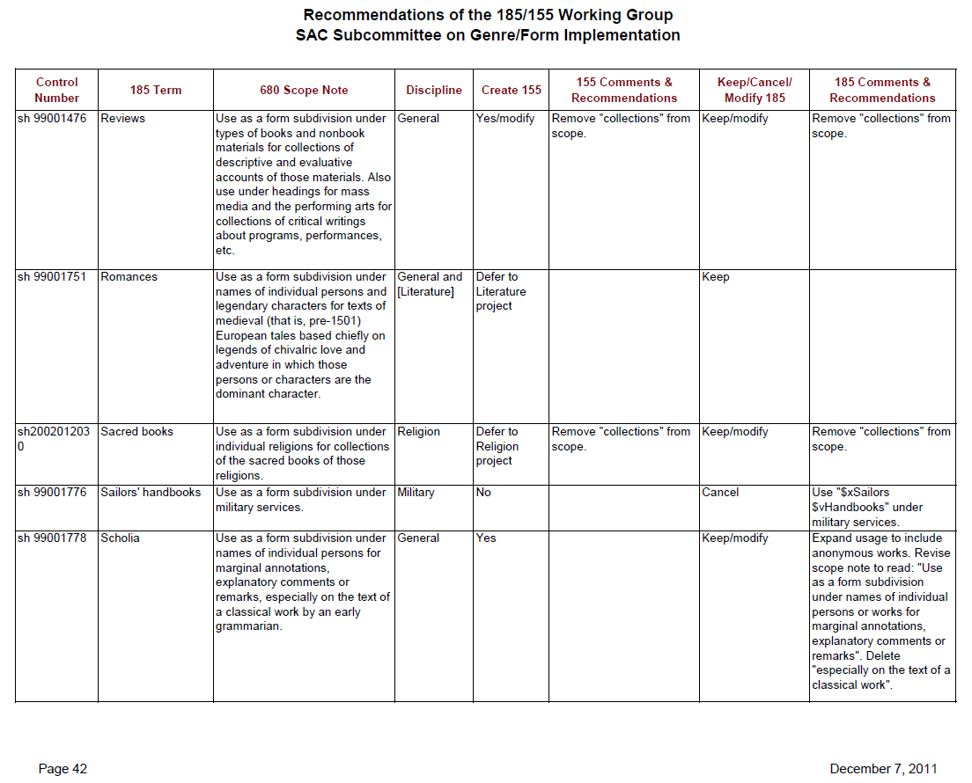

Slide 12
General Terms Working Group
Successor to 185/155 Working Group formed to formulate the initial group of general terms
Also looked at non-free-floating form subdivisions and at other thesauri to identify additional potential general terms
Developed 10 “top” terms: Commemorative works; Creative nonfiction; Derivative works; Discursive works; Ephemera; Illustrated works; Informational works; Instructional and educational works; Recreational works; Tactile works
Negotiated with LC until a final group of terms was included on Tentative Monthly List 13 (January 2015); approved Monthly List of about 190 terms is available at http://classificationweb.net/approved-subjects/1513.html
040 $a has MARC code for ALCTS Subject Analysis Committee: IlChALCS

Slide 13
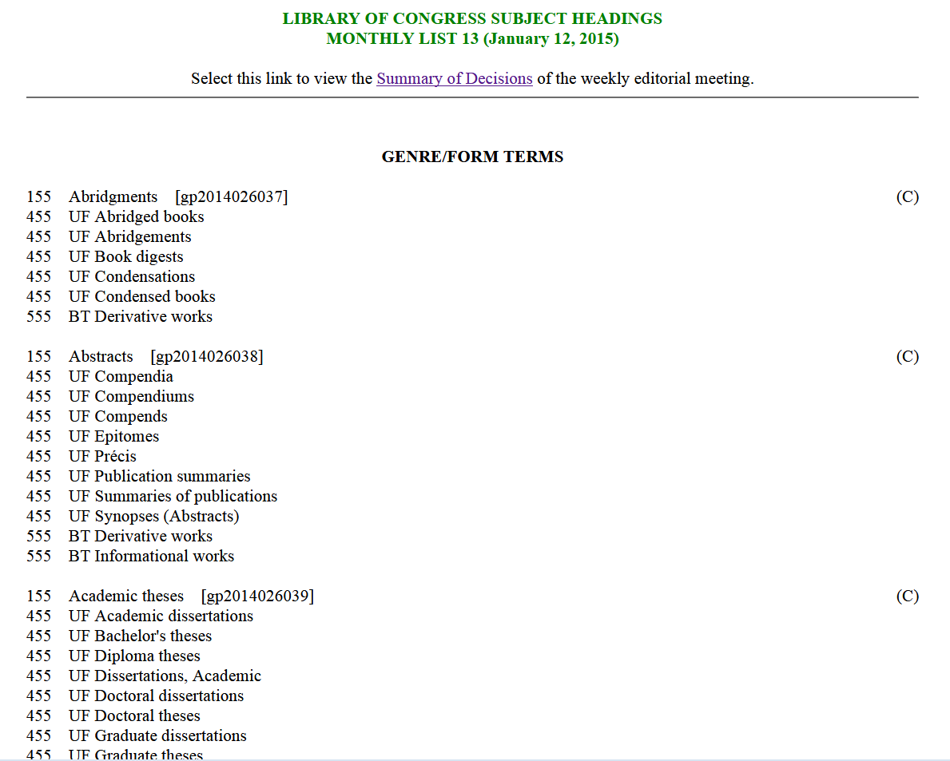

Slide 14
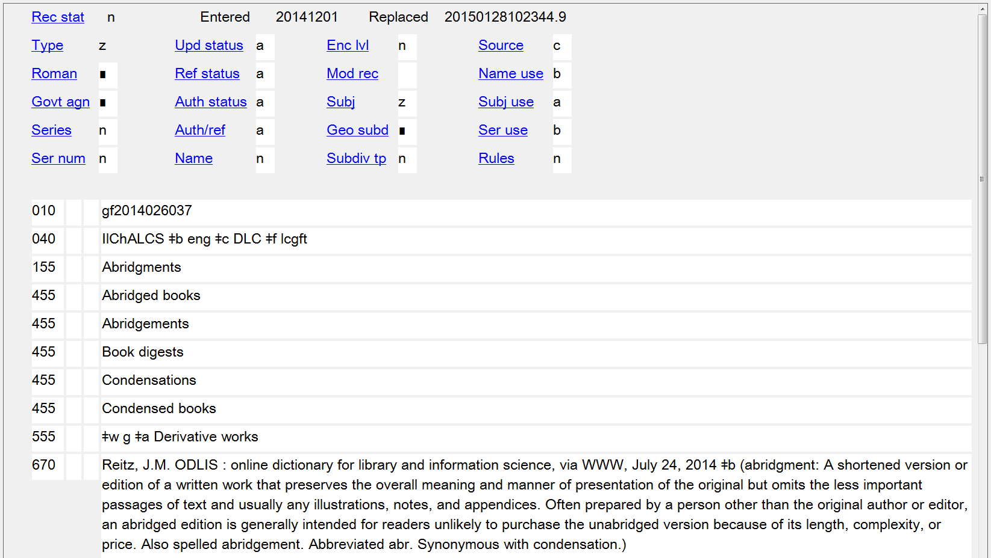

Slide 15
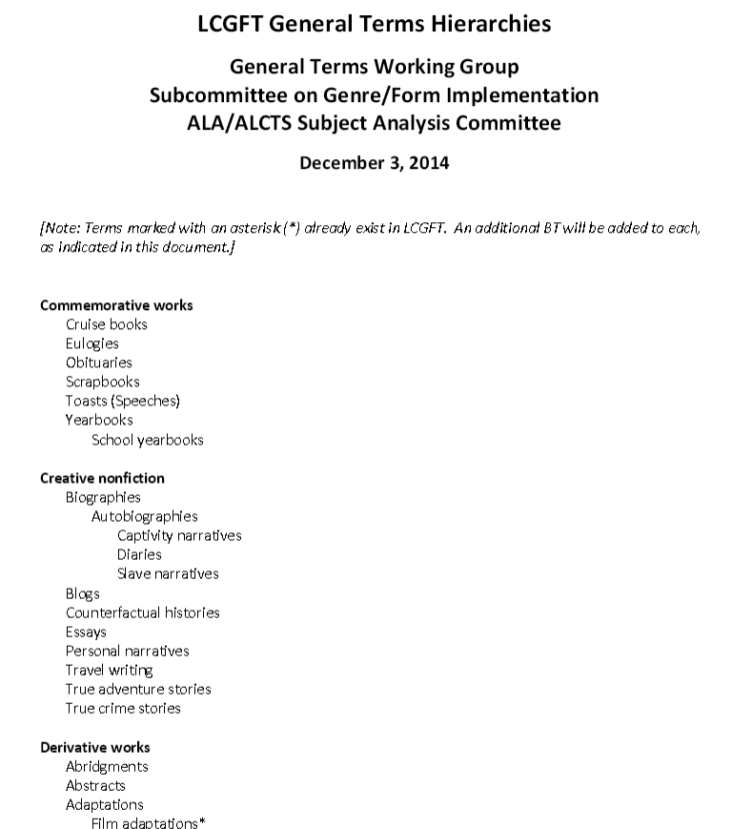
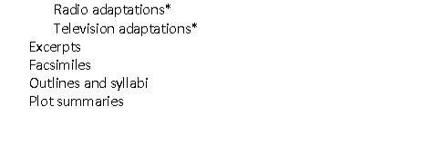
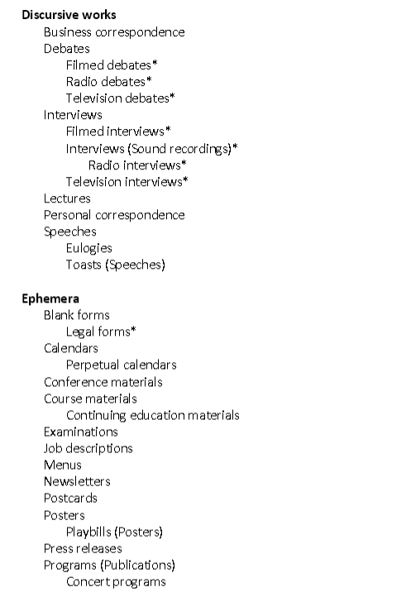
Notes:
LC has posted a hierarchical arrangement of the general terms that the GFIS Working Group created. Note that the current version online, dated December 3, 2014, does not reflect any changes that LC may have made to the records during the editorial process.

Slide 16
Literature Terms Working Group
Goal: to get an initial group of terms for literature into LCGFT that can be used for both individual works and compilations
PSD generated an initial list of potential terms from LCSH
Working group examined other thesauri and reference sources for additional terms
One top term: Literature. Five high-level terms under Literature: Comics (Graphic works); Drama; Fiction; Folk literature; Poetry

Slide 17
Literature Terms Working Group
Negotiated back and forth with LC PSD until a final group of about 400 terms was included on Tentative Monthly List 15 (March 2015); about half of those terms were approved; others were deferred to Monthly List 16 (September 2015) due to workload issues in PSD. Approved Monthly Lists 15-16 are available at http://classificationweb.net/approved-subjects/1515.html and https://classificationweb.net/approved-subjects/1516.html
A group of ethnic performing arts terms were originally deferred by LC, but eventually approved on Monthly List 5 (2016)
040 $a has MARC code for ALCTS SAC: IlChALCS
Notes:
Bullet 2: LC deferred 23 proposed ethnic performing arts terms (e.g., Calonarang plays; Kamishibai plays; Kōwaka drama; Topeng plays): “We're not comfortable adding ethnic performing arts forms to LCGFT at this time. These forms incorporate music, dance, drama, and sometimes other elements as well. We have to carefully consider how (or if) they fit into LCGFT.” LC did end up resolving their questions and approving this group of terms in May 2016.

Slide 18
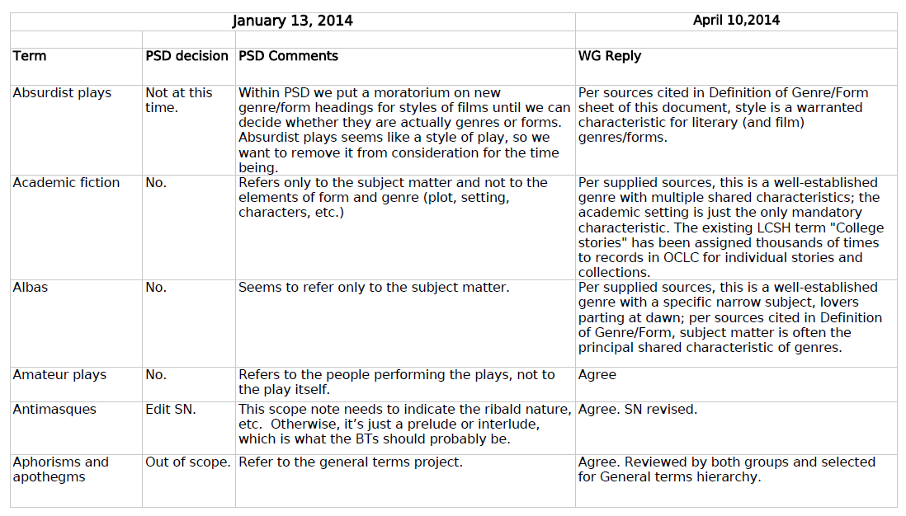

Slide 19
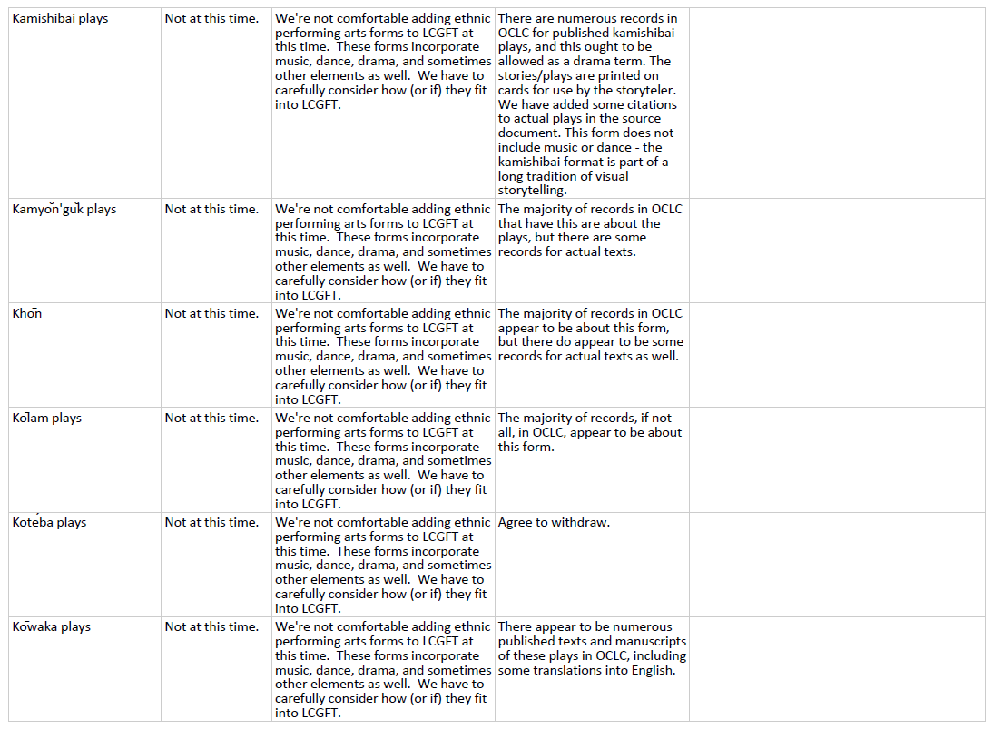

Slide 20
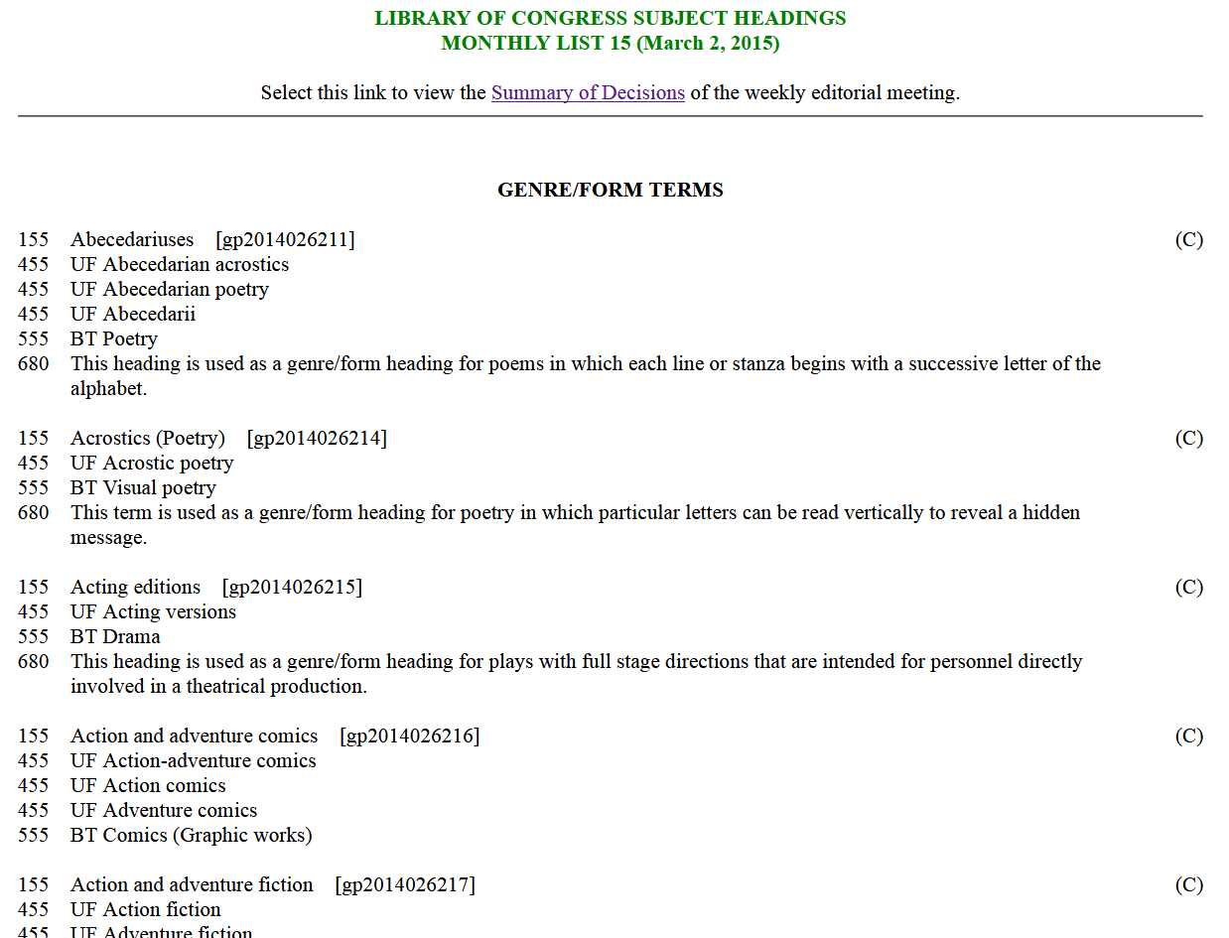

Slide 21
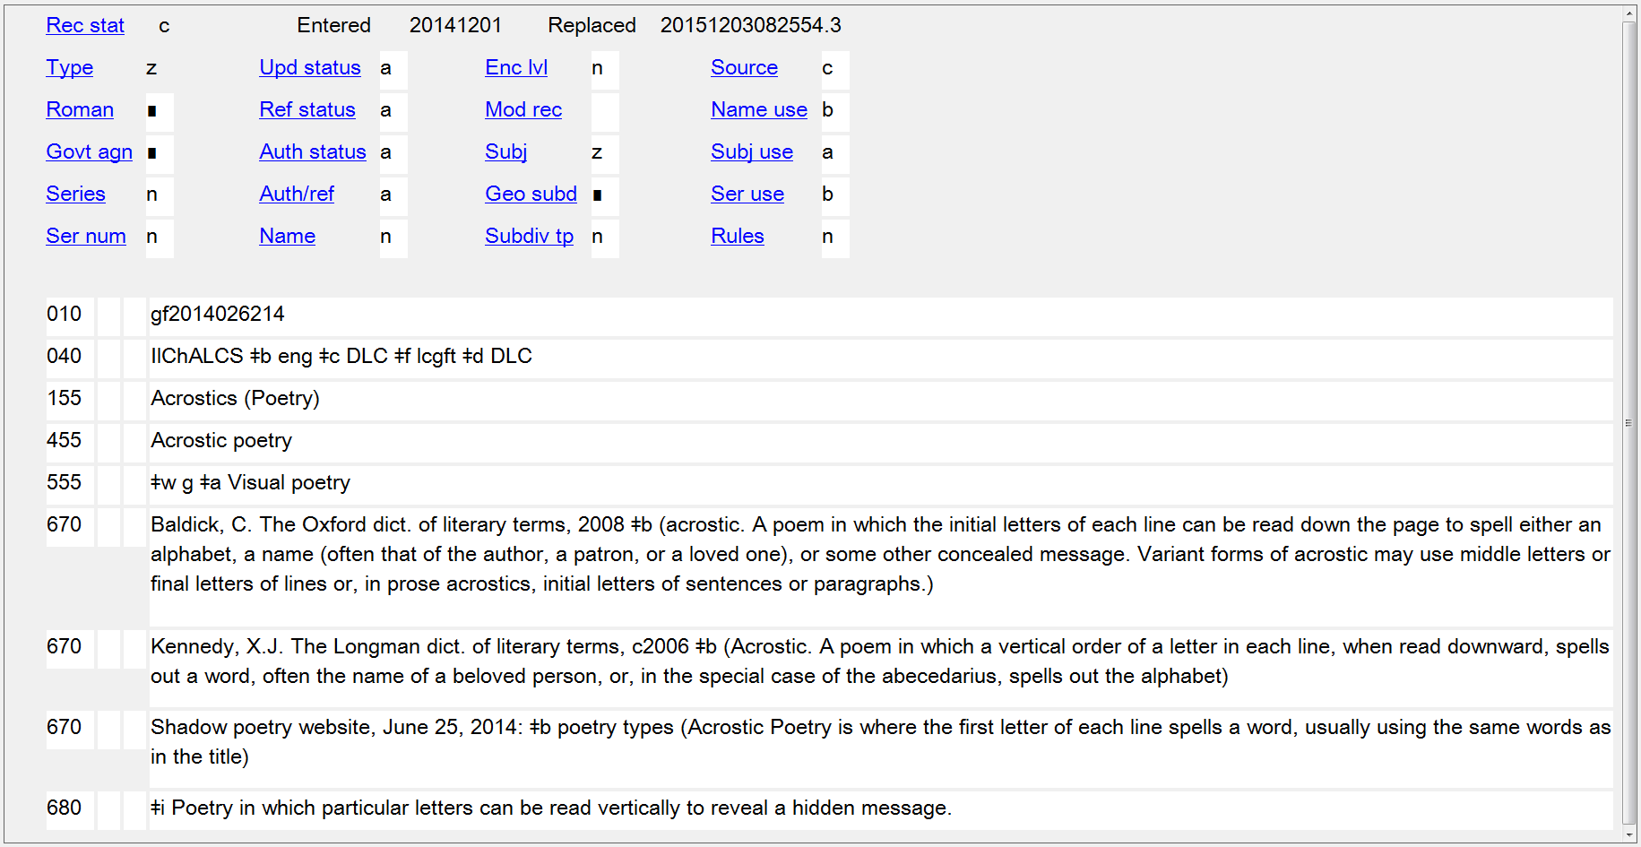

Slide 22
Literature Terms Working Group
As mentioned earlier, there was a process of negotiation back and forth with LC PSD
Not all proposed terms were accepted, e.g., Chick lit; Feminist fiction; Film tie-in fiction; Gentle reads; Manga; Patriotic poetry
Proposals such as Dadaist poetry and Surrealist drama caused LC to determine that terms involving literary movements and styles would not be eligible for inclusion
Some terms originally rejected have later been proposed through SACO (sometimes in a different form) and approved, e.g., Autograph verse; Campus fiction; Ecofiction; Funny animal comics; Sea fiction
Notes:
Chick lit: “This is not a genre, no matter how much it's dressed up.”
Feminist fiction: “Feminist films was approved in the first group of LCGFT terms, but it probably should not have been since it requires a value judgment. We don't want to perpetuate the problem.”
Film tie-in fiction: “This is a form of adaptation and not a genre or form.”
Gentle reads: “There is some discussion over whether ‘gentle reads’ really constitute a genre or form, or whether it is a marketing ploy. Hold off for now.”
Manga: “We’re still not convinced that manga are a separate genre or form. Manga is a style of drawing in comic books, and in addition it means different things to different people.”
Patriotic poetry: “Patriotic films was not approved on ML 1125 because it would require a subjective judgment.”

Slide 23
SAC GFIS and MARC Developments
385 – Audience Characteristics
386 – Creator/Contributor Characteristics
388 – Time Period of Creation
046 – Special Coded Dates
370 – Associated Place

Slide 24
Introduction to Library of Congress Demographic Group Terms
“When LCGFT is fully implemented, LCSH form headings – including those that include both form and audience, or form and creator/contributor characteristics – will no longer be assigned to resources that are for particular audiences, or by members of a particular demographic group. Those headings will be reserved for topical resources about those resources. Since the demographic characteristics of audiences, creators, and contributors are out of scope for LCGFT, another method had to be devised for describing those aspects of resources, or vital information would be lost.”

Slide 25
Audience and Creator/Contributor Characteristics
Explicit indications of audience and creators/contributors of works and expressions are out of scope for LCGFT (although currently there are a few exceptions)
This information needs to be retained somewhere
LCSH: Children’s periodicals LCSH: Young adult fiction
LCGFT: Periodicals LCGFT: Fiction (or Novels, Short stories, etc.)
LCSH: American poetry--Jewish authors LCSH: Artists' writings, French
LCGFT: Poetry LCGFT: Literature

Slide 26
Audience and Creator/Contributor Characteristics
LCDGT was developed in 2015 by LC as a preferred vocabulary to use for these audience and creator/contributor characteristics
SAC GFIS developed the proposals for MARC fields 385 and 386
SAC GFIS developed the group categories that all LCDGT terms belong to and which are included in the LCDGT authority records, and which may optionally be recorded in fields 385 and 386

Slide 27
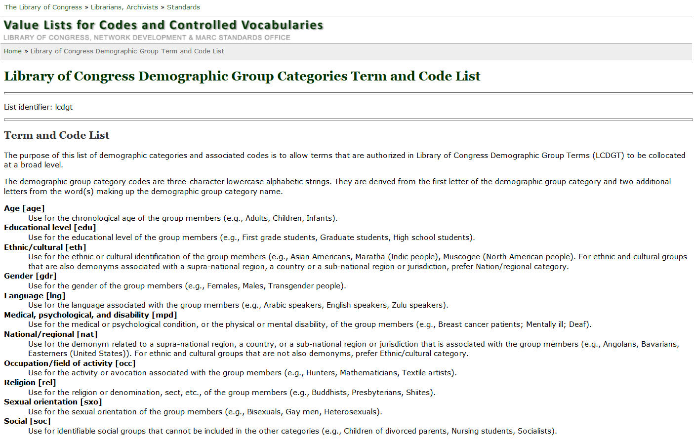
http://www.loc.gov/standards/valuelist/lcdgt.html
Notes:
These are the terms and codes that currently may be used in subfields $m and $n of fields 385 and 386.

Slide 28
043 __ e-gx---
046 __ $k 2016 $2 edtf
050 00 PR9639.3.C535 ǂb W57 2018
082 04 823.914 ǂ2 23
100 1_ Chidgey, Catherine, $d 1970- $e author.
245 14 The wish child : $b a novel / $c Catherine Chidgey.
250 __ First Counterpoint hardcover edition.
264 _1 Berkeley, California : $b Counterpoint, $c 2018.
264 _4 $c ©2017
300 __ 371 pages ; $c 24 cm
386 __ New Zealanders $2 lcdgt
386 __ Women $2 lcdgt
650 _0 World War, 1939-1945 $x Children $z Germany $z Berlin $v Fiction.
655 _7 Historical fiction. $2 lcgft
655 _7 Novels. $2 lcgft

Slide 29
Comp: co
048 __ $b tb02 $a oa
050 14 M1037.4.G8 $b T34 2008
100 1_ Tailleferre, Germaine, $d 1892-1983, $e composer.
240 10 Concertos, $m guitars (2), orchestra
245 10 Concerto pour deux guitares et orchestre / $c Germaine Tailleferre.
300 __ 1 score (77 pages) ; $c 30 cm
382 01 $b guitar $n 2 $a orchestra $e 1 $r 2 $t 1 $2 lcmpt
386 __ French $2 lcdgt
386 __ Women $2 lcdgt
650 _0 Concertos (Guitars (2)) $v Scores.
655 _7 Concertos. $2 lcgft
655 _7 Scores. $2 lcgft

Slide 30
Audn: c Cont: 6
050 00 PZ7.7.N357 $b Fis 2017
082 00 741.5/973 $2 23
100 1_ Napoli, Donna Jo, $d 1948- $e author.
245 10 Fish Girl / $c story by Donna Jo Napoli & David Wiesner ; pictures by David Wiesner.
264 _1 New York, New York : $b Clarion Books, $c [2017]
264 _4 $c ©2017
300 __ 182 pages : $b color illustrations ; $c 27 cm
385 __ $n age $a Preteens $2 lcdgt
386 __ $n nat $a Americans $2 lcdgt
386 __ $n gdr $a Women $2 lcdgt
650 _0 Mermaids $v Comic books, strips, etc.
650 _0 Self-actualization (Psychology) $v Comic books, strips, etc.
650 _0 Sideshows $v Comic books, strips, etc.
650 _0 Marine animals $v Comic books, strips, etc.
655 _7 Fantasy comics. $2 lcgft
655 _7 Graphic novels. $2 lcgft
700 1_ Wiesner, David, $e author, $e artist.

Slide 31
Time Period of Creation
Explicit indications of the time period when works and expressions were created are out of scope of LCGFT
This information needs to be retained somewhere
LCSH: Operas--18th century LCSH: Rock music--1961-1970
LCGFT: Operas LCGFT: Rock music
LCSH: Canadian fiction--20th century LCSH: Literature, Medieval
LCGFT: Fiction LCGFT: Literature
LCDGT: Canadians

Slide 32
Time Period of Creation
SAC GFIS developed the proposal for MARC field 388 (time period of creation term)
SAC GFIS developed the proposal to add subfields $o and $p to MARC field 046 (coded dates for aggregated content)

Slide 33
Medium of Performance
Explicit indications of music medium of performance of works and expressions are out of scope for LCGFT
This information needs to be retained somewhere
LCSH: Cello music (Jazz) LCSH: Sonatas (Balalaika and piano)
LCGFT: Jazz LCGFT: Sonatas
LCSH: Operas--Vocal scores with accordion
LCGFT: Operas and Vocal scores
MARC 382 records medium of performance
LC and Music Library Association together developed Library of Congress Medium of Performance Thesaurus for Music (LCMPT) in 2014

Slide 34
046 __ $k 1955 $2 edtf
100 1_ Andriessen, Jurriaan, $e composer.
240 10 Trios, $m piano, flute, oboe
245 10 Trio no. 1 : $b voor fluit, hobo en piano : 1955 / $c Jurriaan Andriessen.
382 01 flute $n 1 $a oboe $n 1 $a piano $n 1 $s 3 $2 lcmpt
386 __ Dutch $2 lcdgt
386 __ Men $2 lcdgt
500 __ For flute, oboe, and piano.
600 10 Andriessen, Jurriaan $v Manuscripts $v Facsimiles.
650 _0 Music $x Manuscripts $v Facsimiles.
650 _0 Trios (Piano, flute, oboe) $v Scores.
655 _7 Chamber music. $2 lcgft
655 _7 Scores. $2 lcgft
655 _7 Facsimiles. $2 lcgft

Slide 35
Geographic Characteristics
Explicit indications of the geographic place where works and expressions were created or are set are out of scope of LCGFT
This information needs to be retained somewhere
LCSH: American poetry--New York (State)--New York
LCGFT: Poetry
SAC GFIS developed proposal to add $i, $3, and $4 to MARC field 370
SAC GFIS got the term “setting” and code “stg” added to the MARC Code List for Relators

Slide 36
245 00 Last exit to Brooklyn / $c a Neue Constantin Film production ; in
cooperation with Bavaria Film and Allied Filmmakers ; screenplay by
Desmond Nakano ; produced by Bernd Eichinger ; directed by Uli Edel.
257 __ Germany $a Great Britain $2 naf
370 __ $4 stg $i Setting: $f Brooklyn (New York, N.Y.) $2 naf
520 __ Chronicles the lives of a colorful group of small-time hoods and hustlers
in post-war Brooklyn.
650 _0 Neighbors $z New York (State) $z New York $v Drama.
650 _0 Working class $z New York (State) $z New York $v Drama.
651 _0 Brooklyn (New York, N.Y.) $v Drama.
655 _7 Fiction films. $2 lcgft
655 _7 Film adaptations. $2 lcgft
655 _7 Feature films. $2 lcgft
Notes:
370 $f: Other Associated Place
Setting can be recorded in several ways. It is implied in the third subject of this record. It could also be explicitly recorded in 370 as shown in the slide, or in 651 or 751:
651 _0 Brooklyn (New York, N.Y.), $e setting. $4 stg
751 __ Brooklyn (New York, N.Y.), $e setting. $4 stg $2 naf

Slide 37
041 1_ eng $h fre
245 00 Four plays from North Africa / $c edited with an introduction by
Marvin Carlson.
370 __ $g Africa, North $2 lcsh
370 __ $3 The veil ; House of wives: $g Algeria $2 naf
370 __ $3 Araberlin: $g Tunisia $2 naf
370 __ $3 The folies berbers: $g Morocco $2 naf
505 0_ The veil / Abdelkader Alloula (Algeria) -- Araberlin / Jalila Baccar
(Tunisia) -- House of wives / Fatima Gallaire (Algeria) -- The folies
berbers / Tayeb Saddiki (Morocco).
650 _0 North African drama (French) $v Translations into English.
655 _7 Drama. $2 lcgft

Slide 38
043 __ n-mx---
046 __ $k 1960 $2 edtf
245 00 Macario / $c Clasa Films Mundiales S.A. presenta a ; una produccion de Armando
Orive Alba ; director, Roberto Gavaldón.
257 __ Mexico $2 naf
260 __ Coyoacan, México, D.F. : $b Alterfilms : $b Televisa, $c [2003]
380 __ Motion pictures $2 lcgft
650 _0 Poor $z Mexico $v Drama.
650 _0 All Souls' Day $z Mexico $v Drama.
650 _0 Apparitions $v Drama.
650 _0 Death (Personification) $v Drama.
651 _0 Mexico $x History $y Spanish colony, 1540-1810 $v Drama.
655 _7 Magic realist films. $2 lcgft
655 _7 Historical films. $2 lcgft
655 _7 Film adaptations. $2 lcgft
655 _7 Fiction films. $2 lcgft
655 _7 Feature films. $2 lcgft

Slide 39
Brave New (Faceted) World
Facets are the new way of the world
In order for faceted vocabularies to work best, we will need to figure out how to add facets to existing records
SAC GFIS developed mappings of fixed fields and form subdivisions to genre/form and demographic group terms

Slide 40
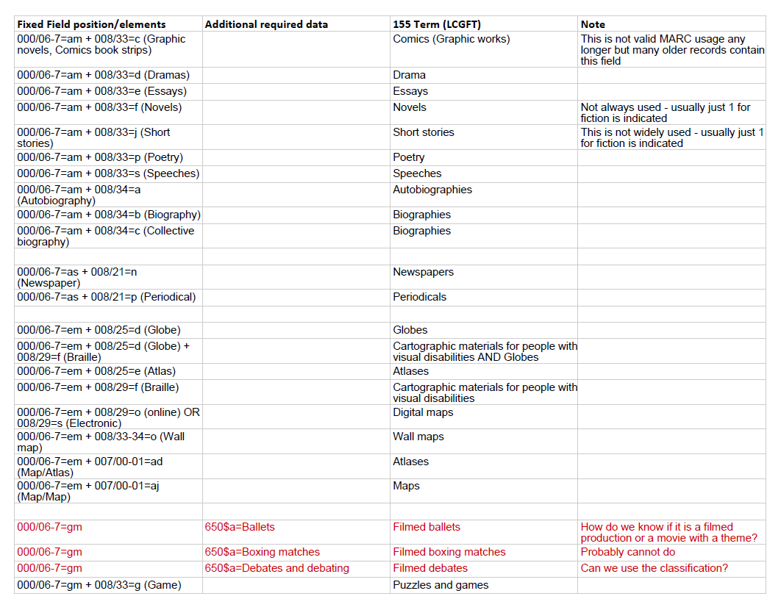

Slide 41
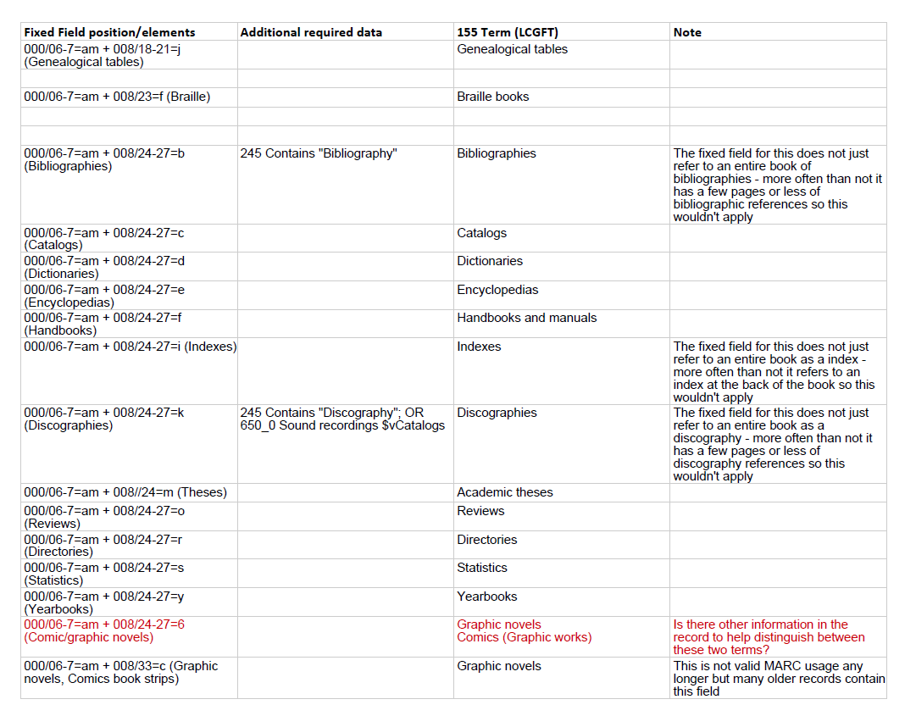

Slide 42
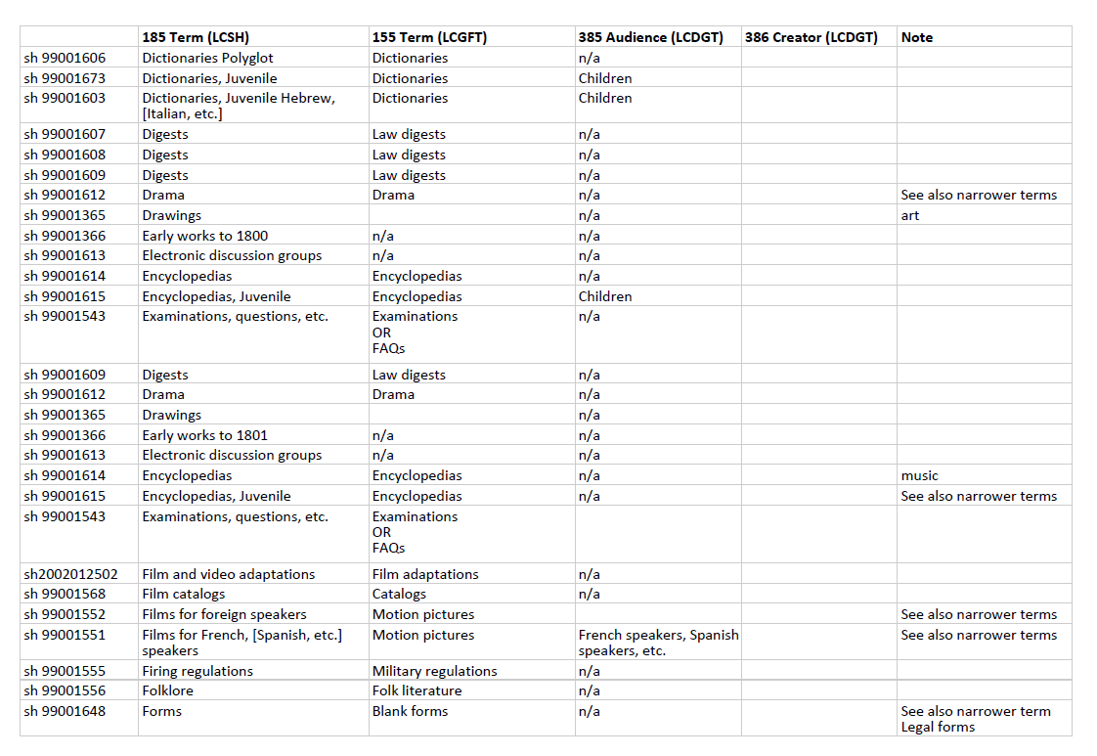

Slide 43
Brave New (Faceted) World
New tools are available to convert bibliographic records to add faceted fields, such as Gary Strawn’s OCLC Music Toolkit, but we need more
Facets have the potential to allow our discovery systems to answer questions that they couldn’t answer in the past, but we need broader implementation
SAC GFIS has been succeeded by the SAC Subcommittee on Faceted Vocabularies (and Lia C. and George P. continue to serve) and it will be developing best practices and additional training materials
Tomorrow’s workshop will focus on the details of applying genre/form and audience and creator/contributor demographic group terms

Slide 44
Thank You!

